Slide 1
Academic Writing And Its Types
Prof Shalini Upadhyay, 2020.

Slide 2
Academic Writing: Definition and Characteristics
Academic writing refers to a style of expression that researchers use to define the intellectual boundaries of their disciplines and their specific areas of expertise.
Characteristics of academic writing include a formal tone, use of the third-person rather than first-person perspective (usually), a clear focus on the research problem under investigation, and precise word choice.
Like specialist languages adopted in other professions, such as, law or medicine, academic writing is designed to convey agreed meaning about complex ideas or concepts for a group of scholarly experts.

Slide 3
Types Of Academic Writing
Descriptive
Analytical
Persuasive
Critical

Slide 4
Descriptive
The simplest type of academic writing is descriptive. Its purpose is to provide facts or information. An example would be a summary of an article or a report of the results of an experiment.
The kinds of instructions for a purely descriptive assignment include: 'identify', 'report', 'record', 'summarise' and 'define'.

Slide 5
Analytical
Analytical writing includes descriptive writing, but also requires you to re-organise the facts and information you describe into categories, groups, parts, types or relationships.
If you’re comparing two theories, you might break your comparison into several parts, for example: how each theory deals with social context, how each theory deals with language learning, and how each theory can be used in practice.
The kinds of instructions for an analytical assignment include: 'analyse', 'compare', 'contrast', 'relate', and 'examine'.

Slide 6
Tips for Analytical Writing
spend plenty of time planning. Brainstorm the facts and ideas, and try different ways of grouping them, according to patterns, parts, similarities and differences. You could use colour-coding, flow charts, tree diagrams or tables.
create a name for the relationships and categories you find. For example, advantages and disadvantages.
build your paragraph around one of the analytical categories.
make the structure of your composition clear to your reader, by using topic sentences and a clear introduction.

Slide 7
Persuasive Writing
Persuasive writing has all the features of analytical writing (that is, information plus re-organising the information), with the addition of your own point of view. Most essays are persuasive, and there is a persuasive element in at least the discussion and conclusion of a research article.
Points of view in academic writing can include an argument, recommendation, interpretation of findings or evaluation of the work of others. In persuasive writing, each claim you make needs to be supported by some evidence, for example a reference to research findings or published sources.
The kinds of instructions for a persuasive assignment include: 'argue', 'evaluate', 'discuss', and 'take a position'.

Slide 8
Tips for persuasive Writing
To present your argument, make sure:
your text develops a coherent argument where all the individual claims work together to support your overall point of view
your reasoning for each claim is clear to the reader
your assumptions are valid
you have evidence for every claim you make
you use evidence that is convincing and directly relevant.

Slide 9
Critical Writing
While persuasive writing requires you to have your own point of view on an issue or topic, critical writing requires you to consider at least two points of view, including your own.
For example, you may explain a researcher's interpretation or argument and then evaluate the merits of the argument, or give your own alternative interpretation.
Examples of critical writing assignments include a critique of a journal article, or a literature review that identifies the strengths and weaknesses of existing research. The kinds of instructions for critical writing include: 'critique', 'debate', 'disagree' and 'evaluate'.

Slide 10
Tips for Critical Writing
You need to:
accurately summarise all or part of the work. This could include identifying the main interpretations, assumptions or methodology.
have an opinion about the work. Appropriate types of opinion could include pointing out some problems with it, proposing an alternative approach that would be better, and/or defending the work against the critiques of others.
provide evidence for your point of view. Depending on the specific assignment and the discipline, different types of evidence may be appropriate, such as logical reasoning, reference to authoritative sources and/or research data.
Note:Critical writing requires strong writing skills. You need to thoroughly understand the topic and the issues. You need to develop essay/paragraph structure that allows you to analyse different interpretations and develop your own argument, supported by evidence.

Slide 11
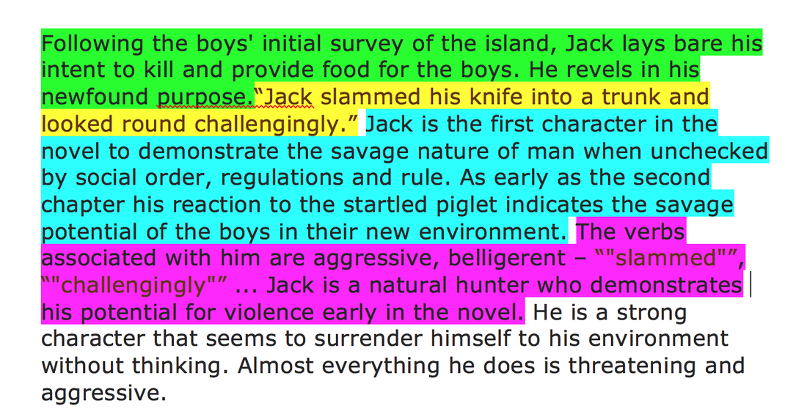
Sample Paragraphs
Critical:

Slide 12
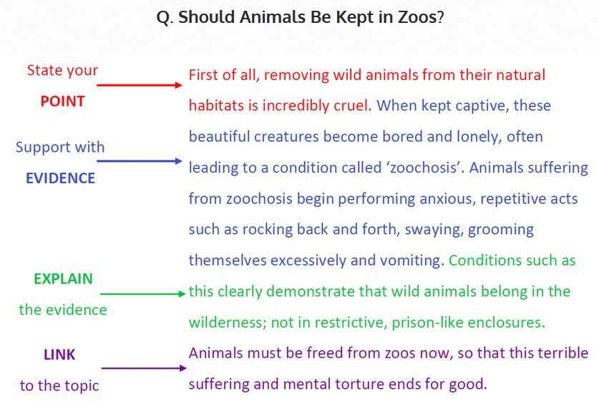
Analytical

Slide 13

Descriptive

Slide 14

Persuasive

Slide 15
More On Analytical Paragraph
Alexander the Great was a successful ruler because he created long lasting effects on cultures that still continue to this day. An example of his legacy would be the creation of a Hellenistic Society. Hellenistic is the combination of Greek, Persian, and Egyptian cultures. During this remarkable time, people were encouraged to pursue a formal education and develop many different kinds of art. New forms of math, science, and art design make a great impact on contemporary society. If this new way of life hadn’t been as successful as it was, Alexander’s legacy wouldn’t be as memorable and groundbreaking. By conquering many countries and merging cultures, Alexander the Great will be credited in history for his many achievements.

Slide 16
A topic sentence, or thesis, that details the main point(s) of the paragraph:
Alexander the Great was a successful ruler because he created long lasting effects on cultures that still continue to this day.
Example (Think of an example that helps support your thesis statement):
An example of his legacy would be the creation of a Hellenistic Society.

Slide 17
Explanation of Example (What does this specific example mean? Be specific. Expand your example by providing additional important details):
Hellenistic is the combination of Greek, Persian, and Egyptian cultures. During this remarkable time, people were encouraged to pursue a formal education and develop many different kinds of art. New forms of math, science, and art design make a great impact on contemporary society
How does the example prove your thesis (Why is this example important? How does it support the main claim of your thesis statement?):
If this new way of life hadn’t been as successful as it was, Alexander’s legacy wouldn’t be as memorable and groundbreaking.
Conclusion Sentence (Sum up the main argument of your paragraph in one sentence):
By conquering many countries and merging cultures, Alexander the Great will be credited in history for his many achievements.

Slide 18
How to Apply Different Types of Writings in a Technical Report?
You will use critical writing in the literature review to show where there is a gap or opportunity in the existing research
The methods section will be mostly descriptive to summarise the methods used to collect and analyse information
The results section will be mostly descriptive and analytical as you report on the data you collected
The discussion section is more analytical, as you relate your findings back to your research questions, and also persuasive, as you propose your interpretations of the findings.

